Slide 1
SpeakOut with Advocatr
Curriculum
Lesson 3
Trust, Respect, and Agreements

Slide 2
Circle Agreements
Respect the talking piece
Listen to understand
Speak the truth as you know it
Be respectful
Respond to the prompt, not to each other
You may pass

Slide 3
Listening Circle
Prompt 1: Name one person you have high respect for and why
Prompt 2: Think of one or two people you trust. What kinds of things do they do or say that earn your trust?

Slide 4
Making Agreements (pair-share)
Prompt 1: Brainstorm some ways we could make this class feel like a respectful place (2mins).
Prompt 2: What are some things that sometimes happen in a class like this that bother you or make you feel unsafe? How can we write up an agreement to prevent that here?

Slide 5
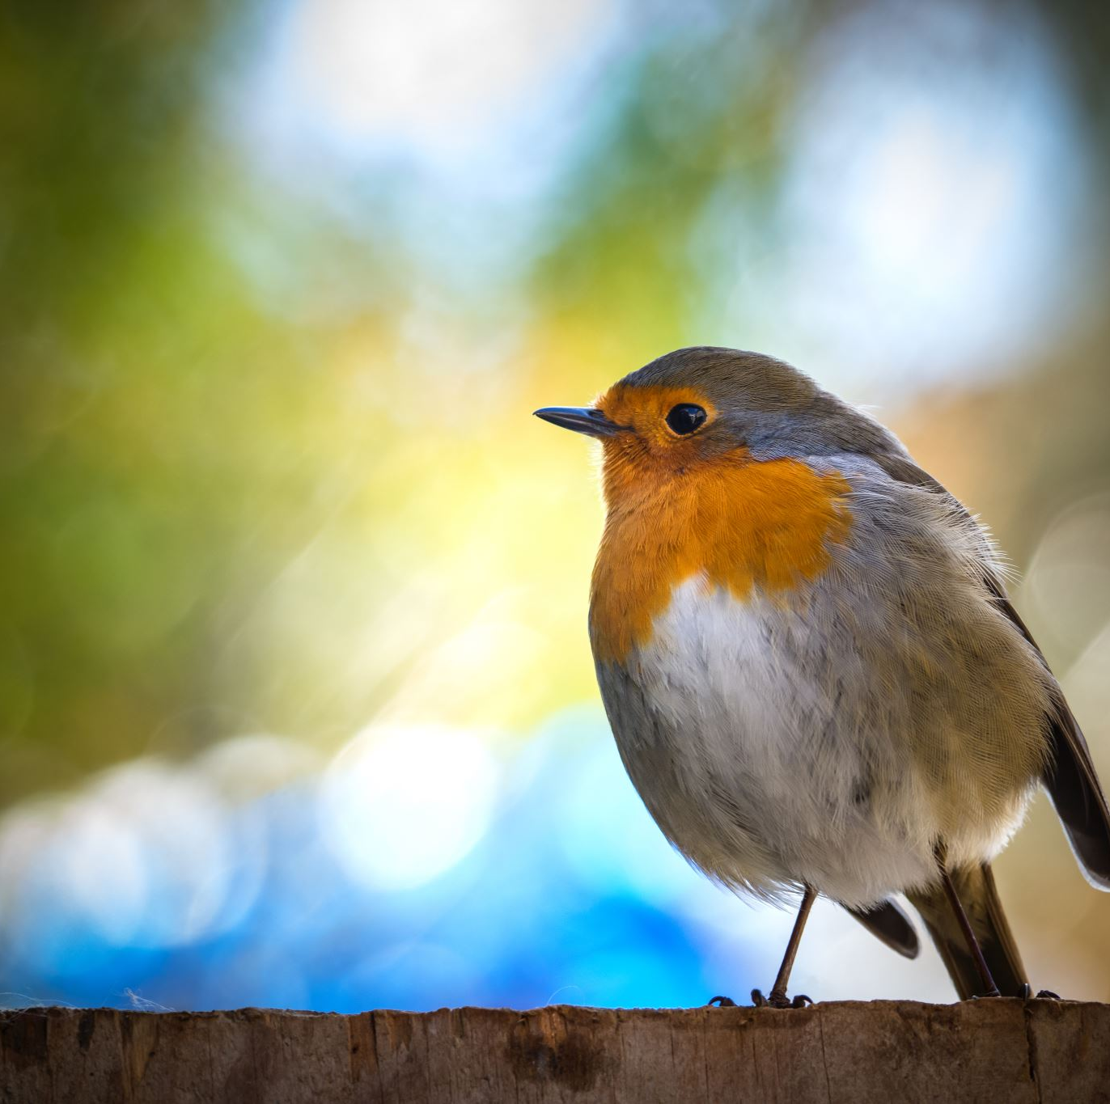
Quote of the Day
A bird sitting on a tree is never afraid of the branch breaking, because its trust is not on the branch but on its own wings.
-unknown author

Slide 6
Please answer one of these questions
What do you think this quote is saying about putting our trust in something or someone else?
If you think of your community as a branch that holds you up, what are some things that make that branch stronger? What might weaken it?
If you think of your own “wings” as the skills and abilities you can rely on to get you through difficult situations, what are those skills and abilities?

